Slide 1




SpaceTrash Hack
SpaceTrash Hack
NASA SPACE APPS CHALLENGE
NASA SPACE APPS CHALLENGE
NASA SPACE APPS CHALLENGE
Revolutionizing Recycling on Mars
Revolutionizing Recycling on Mars
SpaceTrash Hack
Revolutionizing Recycling on Mars
Team
Team
Our Future Home Mars
Our Future Home Mars
Team
Members
Members
Our Future Home Mars
Khayoon Alaayedi and Lujain Mahdi Siham
Khayoon Alaayedi and Lujain Mahdi Siham
Location
Location
Members
from Iraq, Baghdad
from Iraq, Baghdad
Khayoon Alaayedi and Lujain Mahdi Siham
Date
Date
Location
2025 / 10 / 05
2025 / 10 / 05
from Iraq, Baghdad
Date
"Nature produces zero waste. A leaf falls and becomes food for the soil. Our system is inspired by this principle."
"Nature produces zero waste. A leaf falls and becomes food for the soil. Our system is inspired by this principle."
2025 / 10 / 05
It's the 'digestive system' for the Mars habitat, breaking down complex materials (like a stomach), absorbing energy (like mitochondria), and rebuilding them into new, useful structures (like cells).
It's the 'digestive system' for the Mars habitat, breaking down complex materials (like a stomach), absorbing energy (like mitochondria), and rebuilding them into new, useful structures (like cells).
To explore our interactive 3D simulation: https://jsfiddle.net/f3jarsz4/3/

Slide 2

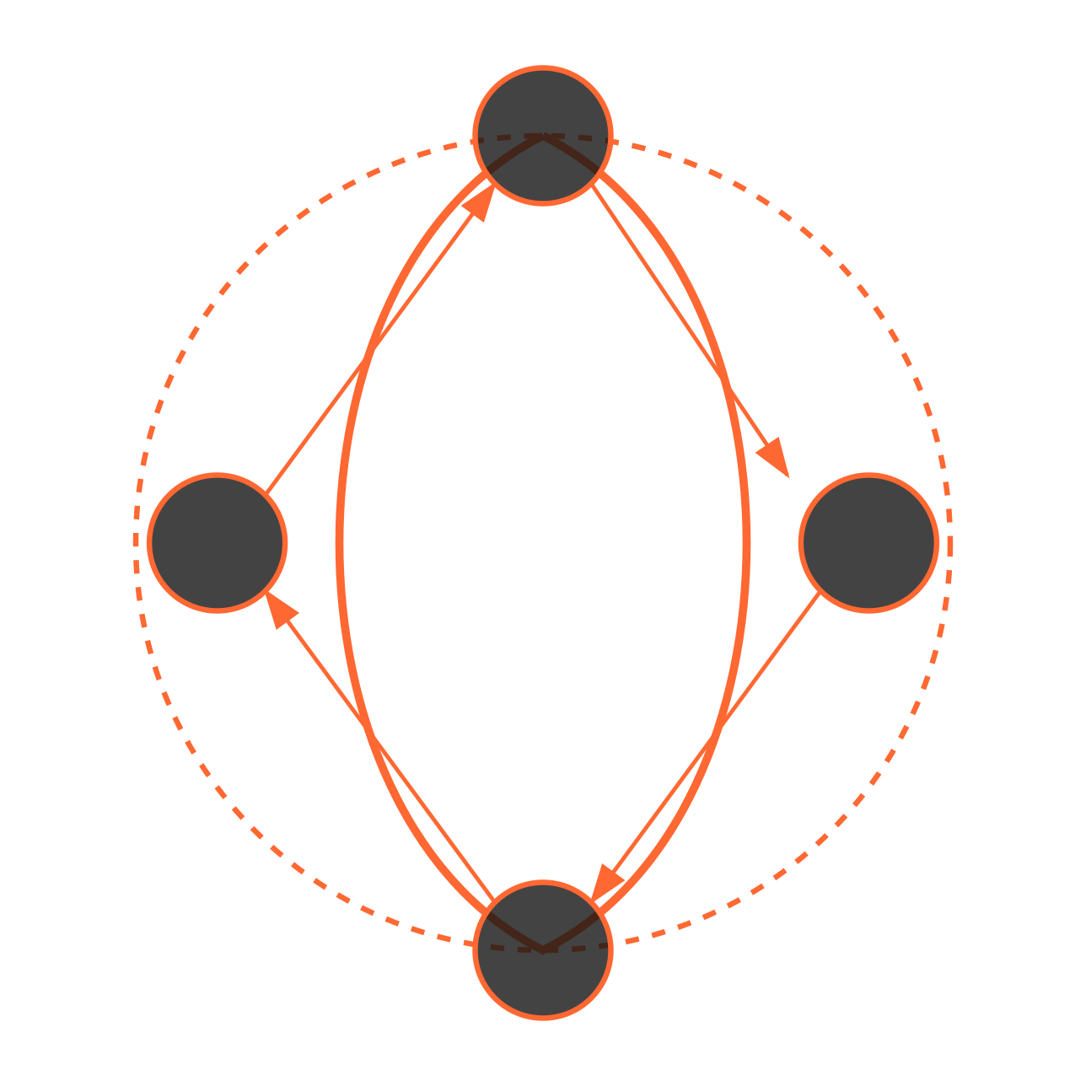



MARS MISSION // RECYCLING SYSTEMS
MARS MISSION // RECYCLING SYSTEMS
JEZERO CRATER · SOL 752 · MARS
JEZERO CRATER · SOL 752 · MARS
Vision: Closing the Resource Loop on Mars
Vision: Closing the Resource Loop on Mars
Sustainable Systems
Sustainable Systems
CLOSED-LOOP RESOURCE MODEL
CLOSED-LOOP RESOURCE MODEL
Our project envisions a fully integrated modular recycling system that transforms all waste streams into valuable resources, eliminating the concept of "trash" on Mars missions and establishing a foundation for long-term settlement.
Our project envisions a fully integrated modular recycling system that transforms all waste streams into valuable resources, eliminating the concept of "trash" on Mars missions and establishing a foundation for long-term settlement.
WASTE
PRODUCTS
PROCESS
In-Situ Resource Utilization
In-Situ Resource Utilization
Combine recycled materials with Martian regolith
Combine recycled materials with Martian regolith
Recover water and volatiles from waste streams
Recover water and volatiles from waste streams
Generate partial energy from waste processing
Generate partial energy from waste processing
Minimize reliance on Earth resupply missions
Minimize reliance on Earth resupply missions
MATERIALS
Circular Economy
Circular Economy
Every item brought to Mars has multiple life cycles through our system. Waste becomes raw material, which becomes new products, eventually returning to the recycling loop when their utility ends.
Every item brought to Mars has multiple life cycles through our system. Waste becomes raw material, which becomes new products, eventually returning to the recycling loop when their utility ends.
Sustainable circular resource flow for Mars habitation
SPACETRASH HACK // OUR FUTURE HOME MARS
Sustainable circular resource flow for Mars habitation
SPACETRASH HACK // OUR FUTURE HOME MARS
3/25
3/25

Slide 3
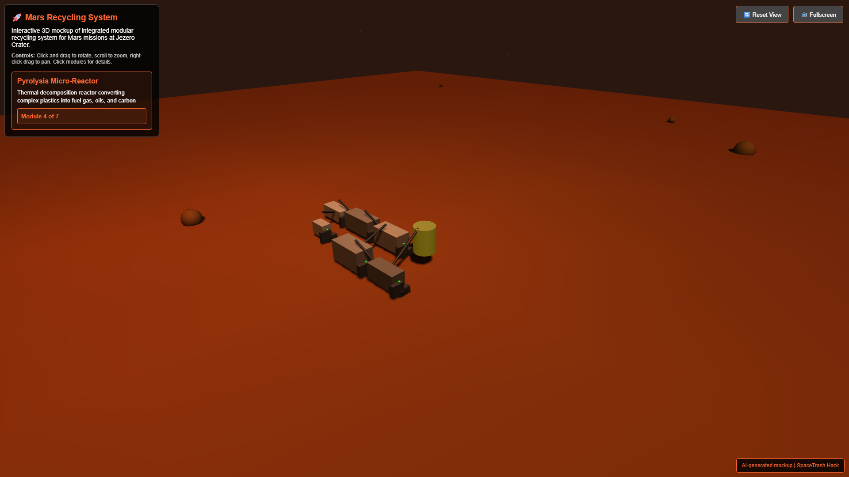
SYSTEM ARCHITECTURE // MODULAR RECYCLING
TECHNICAL DIAGRAM · MODULE FLOW · MARS
System Architecture Diagram
INTEGRATED WASTE RECYCLING SYSTEM
MARS BASE · JEZERO CRATER
1
2
3
4
Waste Input
Processing
Resource Recovery
Final Products
SPACETRASH HACK // OUR FUTURE HOME MARS
6/25

Slide 4






MARS MISSION // RECYCLING SYSTEMS
JEZERO CRATER · SOL 752 · MARS
Pyrolysis Micro-Reactor Module
Process Overview
PYROLYSIS PROCESS VISUALIZATION
Thermal decomposition chamber that processes mixed/complex plastics in low-oxygen conditions. Specialized for multilayer food packaging and composite materials that cannot be directly extruded.
Gas
Mixed Waste Input
Energy
Recovery
Loop
Technical Specifications
Heat Source
Operating Temperature: 400-600°C
Carbon
Capacity: 0.5-2 kg/hour
Power Usage: 0.8-1.5 kW
Oil/Wax
Thermal Recovery Efficiency: 65-70%
Gaseous Product Yield: 15-25%
Liquid/Wax Yield: 40-60%
Carbon/Char Yield: 20-30%
Output Utilization
25-30%
Gas: Redirected as heating fuel for other modules
65-70%
0.6-0.8 kW
Liquid/Wax: Used as binder or secondary fuel source
Thermal
Energy
System Mass
Carbon/Char: Filler for composite materials or conductive elements
Efficiency
Recovery
Reduction
Energy Recovery Performance
SPACETRASH HACK // OUR FUTURE HOME MARS
10/25

Slide 5
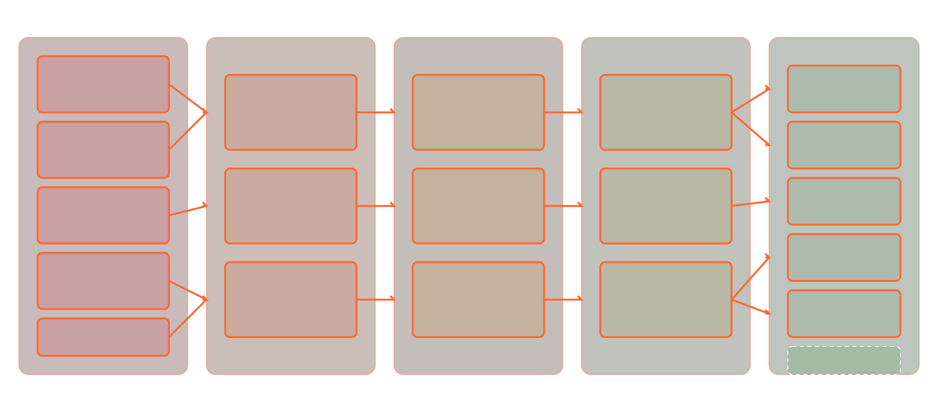
SYSTEM WORKFLOW // PROCESS VISUALIZATION
END-TO-END PROCESS · MATERIAL FLOW · MARS
System Workflow: End-to-End Process
WASTE TO RESOURCE TRANSFORMATION
CIRCULAR ECONOMY FLOW
WASTE INPUT
PREPROCESSING
PROCESSING
MANUFACTURING
FINAL PRODUCTS
Fabric Waste
Tools & Parts
Sorting &Preprocessing
Extrusion &Filament Production
Composite 3D Printing
Food Packaging
Construction Materials
Shredding &Drying
Pyrolysis Micro-Reactor
Insulation
Structural Elements
Molding &Forming
Energy Source
Foam Packaging
Material Segregation
Foam Processor
Energy Recovery
Habitat Elements
Other Materials
Zero Waste Goal
SPACETRASH HACK // OUR FUTURE HOME MARS
18/25

Slide 6




MARS MISSION // RECYCLING SYSTEMS
JEZERO CRATER · SOL 752 · MARS
System Impact Assessment
Resource Savings
SUSTAINABILITY METRICS
Mass Reduction: 12,600 kg recovered for 8-person crew over 3 years
Waste Reduction & Resource Recovery
Volume Optimization: 40% habitat space recovery
Energy Recovery: 15-20% energy recapture via pyrolysis
Water Conservation: 98% recycling efficiency with minimal processing water
Environmental Impact Rating
Mission Enablement
92%
Extended mission duration by up to 30%
Superior to standard waste disposal methods by 92%
Enhanced habitat sustainability and self-sufficiency
Long-term ROI Analysis
Improved crew safety through rapid parts manufacturing
Reduced dependency on resupply missions
4x
6x
8x
Testing ground for circular economy principles for future settlements
Resource
Mission
Long-term
Utilization
Extension
Value
SPACETRASH HACK // OUR FUTURE HOME MARS
21/25

Slide 7
STORYTALE // CYCLES OF RENEWAL
SPACETRASH HACK · 2025 · MARS
Cycles of Renewal
Our Future Home Mars
"From Mars dust we rise, into Mars potential we transform. We are the bridge between Earth's wisdom and Mars' future."
Khayoon Alaayedi and Lujain Mahdi Siham
from Iraq, Baghdad
In the heart of space, every drop of water, every breath of air, and every fragment of material becomes priceless. Out there, far from Earth's abundance, astronauts cannot afford the luxury of waste. Our system emerges as more than just technology—it becomes a philosophy of survival, a companion that transforms scarcity into opportunity.
For astronauts, this means independence. It means fewer supplies to carry, lower costs for missions, and a future where they can create what they need, when they need it. No longer just consumers, they become producers, innovators, and caretakers of their own environment. The system does not only reduce burden—it inspires new possibilities for long-term life beyond Earth.
What once weighed missions down as waste is reborn as fuel for progress. What once was overlooked becomes the foundation of endurance. This is more than a device; it is a bridge between Earth's wisdom and space's vast frontier. It reflects the belief that sustainability is not a choice—it is the key to survival, and survival itself is the seed of creation.
Like Earth herself, who takes decay and reshapes it into new life, our design follows the same eternal rhythm of renewal. Nothing is ever truly lost; what was once discarded finds a new beginning. Waste becomes resource, limits become possibilities, and astronauts carry with them a cycle as ancient and wise as nature itself.
This is not simply recycling. It is a living circle of creation. It is a reminder that humanity, even when millions of miles from home, carries the genius of sustainability within its hands. In every cycle, the system grants strength, security, and freedom, offering explorers the power to not only survive—but to flourish.
In the silence of the cosmos, our solution whispers a timeless truth: just as Earth recycles her seasons, so too will humanity recycle its future. With this system, every journey into the unknown carries the promise of renewal, the assurance of continuity, and the spark of life that transforms emptiness into hope.
7/7
98%
7
3x
Waste Recycled
Integrated Modules
Mission Extension

